Slide 1
Qualitative Research
Tim Pengajar MPPI

Slide 2
Qualitative Research ?
Qualitative research differs from the aim of quantitative research, it “answers questions about what is happening in a particular situation” (Peszynski 2005, p. 50).
“Qualitative researchers attempt to secure an in-depth understanding of phenomena that are situated in the scientific world” (Ellet and Beausang 2002, p. 10).
A qualitative research is “of an exploratory nature, the variables are unknown, the context is important and there is a lack of theory” (Peszynski 2005, p. 50).
It “is characteristically exploratory, fluid and flexible, data-driven and context-sensitive” (Mason 2002, p. 24).
Most of the qualitative research methodologies “focus on exploring the contextually based, lived experience of individuals and social groups” (Zimmer 2006, p. 315).

Slide 3
A number of characteristics of qualitative method/research (Recker 20013)
Natural setting: Qualitative research is performed in the field, studying a phenomenon in the context in which it occurs.
Researchers as a key instrument:
Qualitative researchers collect data and information themselves (rather than through an ‘objective’ instrument),
often through face-to-face interactions, observing behaviours, studying documents, or interviewing participants.

Slide 4
A number of characteristics of qualitative method/research (Recker 20013)
Multiple sources of data: Qualitative researchers typically gather a variety of data of different sorts, from interviews to documents to observations and so forth.
Inductive analysis: Qualitative methods emphasise bottom-up analysis of data and the build-up of patterns, themes, and concepts into increasingly abstract units from the data.

Slide 5
A number of characteristics of qualitative method/research (Recker 20013)
Focus on emergent meaning: Qualitative methods focus on uncovering or learning the meaning of behaviours, opinions, or views that participants have about a phenomenon.
Evolutionary design: Qualitative methods, while following a general procedure, typically follow an evolutionary research process in which a research plan, a theory, data collection, or analysis can unfold and change over time as the research progresses.

Slide 6
A number of characteristics of qualitative method/research (Recker 20013)
Interpretive:
Researchers develop interpretations of the data they collect and analyse, often in the form of suggested conceptualisations of theories about the phenomenon of study.
Interpretations are inherently subjective, historically and contextually bound to the researcher developing and expressing the interpretation.
Holistic and contextual:
Qualitative methods are designed to assist researchers in developing a comprehensive, detailed picture of complex phenomena.
This typically means shedding light onto a phenomenon from multiple perspectives, developing a larger picture and paying attention to various aspects of the phenomenon without isolating or reducing to one or few dedicated variables.

Slide 7
Data Collection Techniques In Qualitative Research
Interview
Observation
Direct observation or participant observation (Recker 2013)
Document
The researcher’s impressions and reactions (Myers 1997)

Slide 8
Triangulation
Doing more than just one thing. Data triangulation refers to perusing, and relating, multiple sources of evidence about a particular phenomenon or topic. (Recker 2013)
For example, researchers might triangulate interview data with data published in an organisational report or with observational data. (Recker 2013)

Slide 9
Some common research methods under the qualitative paradigm (Recker 2013)
Case study
Action research
Grounded theory
Ethnography
Phenomenology
Hermeneutics

Slide 10
Grounded theory
The researcher attempts to derive a general, abstract theory of a process, action, or interaction grounded in the views of participants in a study (Creswell 2002)
Two primary characteristics of this design are (Creswell 2002) :
The constant comparison of data with emerging categories
Theoretical sampling of different groups to maximize the similarities and the differences of information
Open Coding → Axial/Selective Coding → Theoretical Coding

Slide 11
Phenomenology
Is the study of things as they appear (phenomena) (Smith 2009).
The researcher identifies the "essence" of human experiences concerning a phenomenon, as described by participants in a study. (Creswell 2002)

Slide 12
Hermeneutic
The term ‘hermeneutic’ is derived from Greek language, that is ‘to interpret’ or ‘to understand’ (Hart 2010).
The name hermeneutics is associated with “Hermes”, that is the Greek god of communication, the borders, the limits (Barojas 2008).
The key word of hermeneutics is interpretation (Runardotter 2007).

Slide 13
Hermeneutic
As a mode of analysis, hermeneutic suggests a way of understanding textual data (Myers 1997).
Or text-analogue (an example of a text-analogue is an organization or a record that have been created by authors) (Myers 1997; Lukaitis and Cybulski 2005)
Hermeneutic can also be done to interpreting the meaning of experiences and symbolic artefacts (such as art or sculpture or architecture) (Gupta 2008).

Slide 14
Hermeneutic
Hermeneutic initially focusing on the interpretation of sacred texts and law. Since the main object of hermeneutic is text, then hermeneutic closely associated with the reading process (O’Farrill 2008).
The use of hermeneutics has grown from its roots in the interpretation of Greek classical literature (Von Zwek et. al. 2008).
Currently, hermeneutic also be used in making the interpretation of texts in other disciplines.

Slide 15
Hermeneutic
Hermeneutic interpretation performed with a fundamental principle called the hermeneutic circle (Klein and Myers 1999).
This principle suggests that all human understanding is achieved by iterating between considering the interdependent meaning of parts and the whole that they form (Klein and Myers 1999).

Slide 16
Hermeneutic
In this hermeneutic circle principle, interpretations made from a specific section ("part") and then moves to the common section ("whole"), then return from ("whole") toward ("part") (Klein and Myers 1999).
As implied in (Lukaitis and Cybulski 2005), the term ”part” and “whole” can be whatever that means to the enquirer.
This is done iteratively in order to get a thorough understanding (Klein and Myers 1999).

Slide 17

Hermeneutic
Nowadays, it has a lot of software that can be used to perform hermeneutic.
The software does not remove the need for thought, as the choice of themes remains the responsibility of the researcher (Walsham 2006).
One of the software, that widely being used to do the hermeneutic circle principle is Atlas.ti.
By using Atlas.ti, we can do some coding process in a Hermeneutic Unit (HU), build the network from that codes and interpret the resulted network.

Slide 18
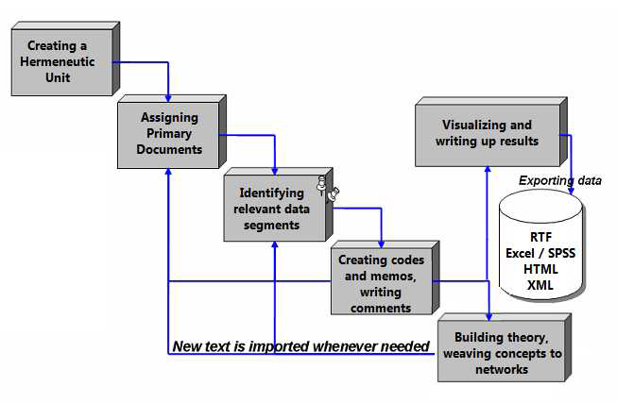
Hermeneutic
Some steps that are used in Atlas.ti (Friese 2011) :

Slide 19
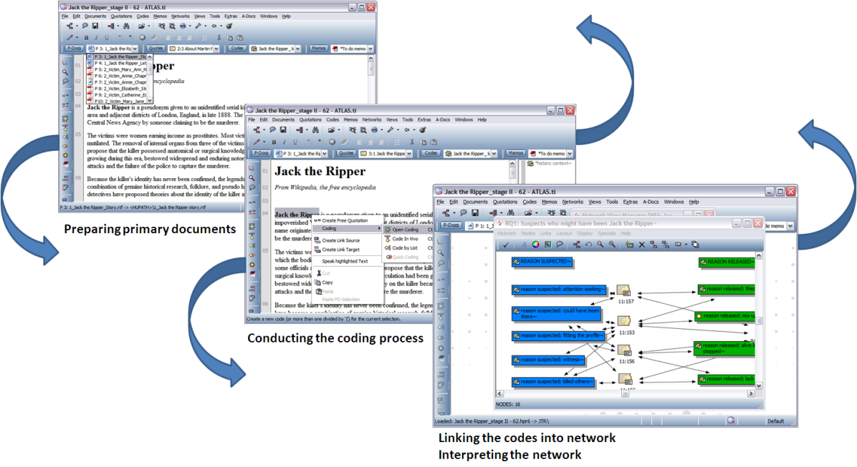
Hermeneutic
Ramadhan (2013) adopt those steps to become 3 simple steps i.e.:
Preparing primary documents,
Conducting coding process,
Linking the codes into network and interpreting the network.

Slide 20
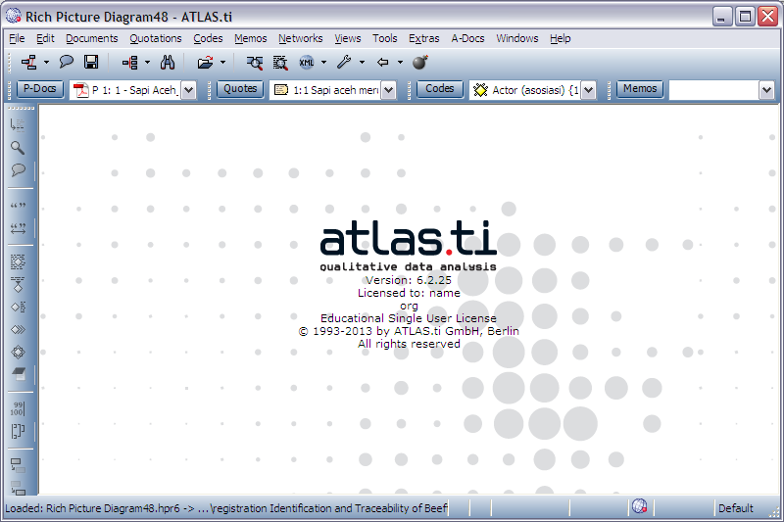
Hermeneutic
Example : “Suppose we want to find the killer, based on some evidences that we have”
Open Atlas.ti

Slide 21
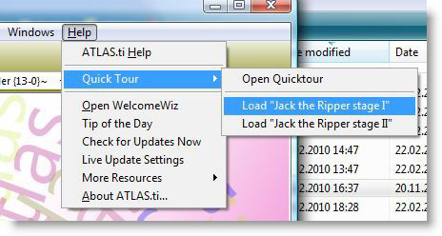

Hermeneutic
Open a Project :
Select one of the existing Primary Document

Slide 22
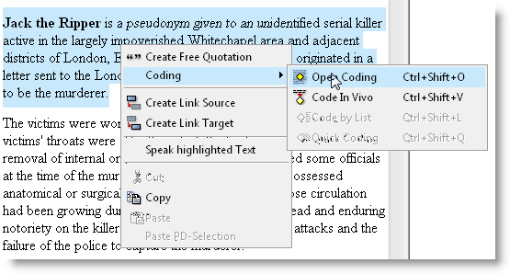
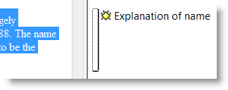
Hermeneutic
Choose words / phrases / sentences that are considered important, and create a Code for that words / phrases / sentences:
Examples of the Code:

Slide 23
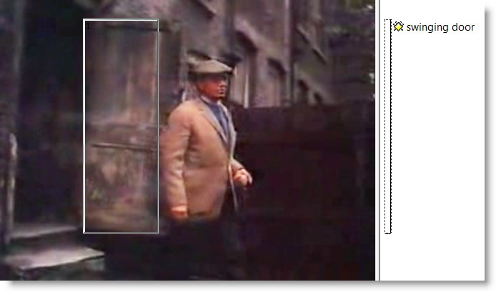
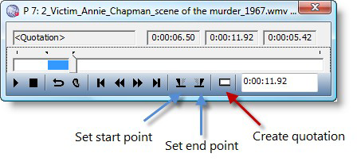
Hermeneutic
Coding process to an Image:
Coding process to an audio or video file:

Slide 24
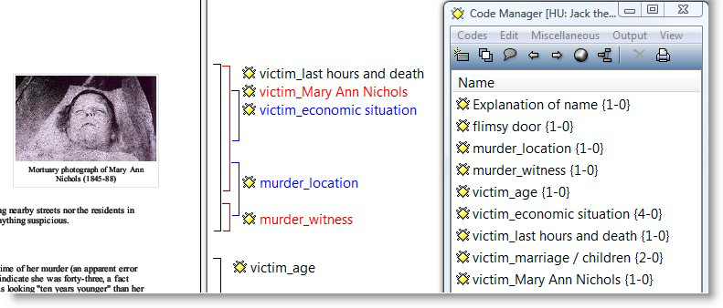
Hermeneutic
Examples of "Primary Documents" that have undergone coding process several times:

Slide 25
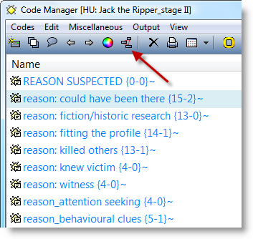
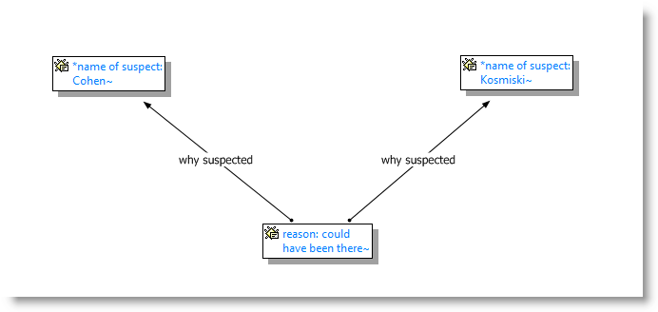
Hermeneutic
Creating the Network (manually, based on our interpretation):
Example: →

Slide 26
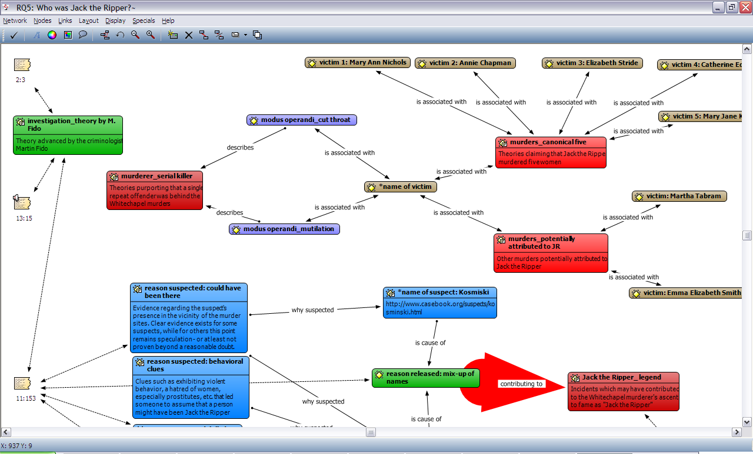
Hermeneutic
More complex result :

Slide 27
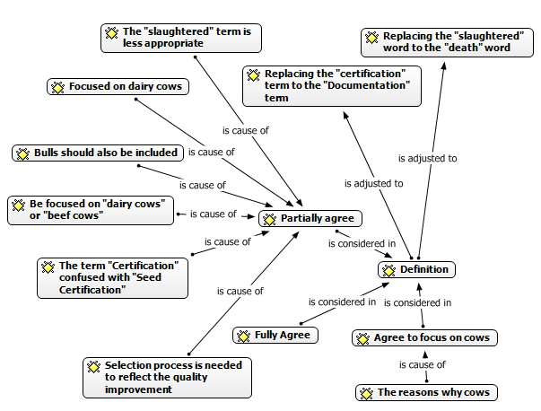
Hermeneutic
An example from Ramadhan (2013)

Slide 28
The Quality of Qualitative Research
Reliability and validity are rooted in positivism (Golafshani 2003).
Positivist perspective is often associated with quantitative analysis
Qualitative researchers bring to their research a different lens toward validity than that brought to traditional quantitative research (Creswell and Miller 2000).

Slide 29
The Quality of Qualitative Research
Guba (1981) suggested four criteria that can be used to assess the trustworthiness of naturalistic/interpretive inquiry, ie.
Credibility
Transferability
Dependability
Confirmability.
Shenton (2004) suggests that those four criteria can be used to ensuring trustworthiness in all qualitative research.

Slide 30
The Quality of Qualitative Research
Guba (1981) :
Aspects | Rationalistic (positivistic) paradigm | Naturalistic (interpretive) paradigm
Truth value | Internal validity | Credibility
Applicability | External validity | Transferability
Consistency | Reliability | Dependability
Neutrality | Objectivity | Confirmability

Slide 31
Credibility
Testing the credibility of the findings and interpretations with the various sources (au- diences or groups) from which data were drawn (Guba 1981).
The testing of credibility is often referred to as doing ‘member checks,’ that is, testing the data with members of the relevant human data source groups (Guba 1981).

Slide 32
How to ensure Credibility
Adopt all of the appropriate research methods/methodologhy (as suggested by Shenton (2004))
Develop an early familiarity with the culture of participating organisations before the first data collection dialogues take place (as suggested by Shenton (2004))
Use triangulation (as suggested by Guba (1981) and Shenton (2004))
All of the respondents’ identity are known and clear in the research (as implied by Axelsson and Goldkuhl (2004))

Slide 33
How to ensure Credibility
To do the “member check”, the research progresses is published in several international journal or conferences (as exemplified by Pielstick (2005))
Ensure the honesty in informants when contributing data (as suggested by Shenton (2004))
Use the iterative questioning (as suggested by Shenton (2004))
Debriefing sessions with research supervisors frequently (as suggested by Shenton (2004))
Collect all referential adequacy materials, for example the interviews and FGD process are recorded and transcribed (as suggested by Guba (1981))

Slide 34
Transferability
The naturalists assumes that “generalizations of the rationalistic variety are not possible because phenomena are intimately tied to the times and the contexts in which they are found” (Guba 1981).
For the naturalist, then, the concept analogous to generalizability (or external validity) is transferability, which is itself dependent upon the degree of similarity (fittingness) between two contexts” (Guba 1981).
The naturalist does not attempt to form generalizations that will hold in all times and in all places, but to form working hypotheses that may be transferred from one context to another depending upon the degree of ‘fit’ between the contexts” (Guba 1981).

Slide 35
How to ensure Transferability
Researcher has used purposive sampling to choose the interviewees that are involved in this research (as suggested by Guba (1981))
A thick description also have been made in this research (as suggested by Guba (1981))

Slide 36
Dependability
Consistency is a trickier concept for the naturalist than for the rationalist (Guba 1981).
Naturalist believes “in a multiple reality and using humans as instruments”, so that “some portion of observed instability is ‘real’.” (Guba 1981).
Thus, for the naturalist, the concept of consistency implies not invariance (except by chance) but trackable variance-variance that can be ascribed to sources: so much for error, so much for reality shifts, so much for increased instrumental proficiency (better insights), and so on (Guba 1981).
The naturalist thus interprets consistency as dependability, a concept that embraces elements both of the stability implied by the rationalistic term reliable and of the trackability required by explainable changes in instrumentation (Guba 1981).

Slide 37
How to ensure Dependability
As suggested by Shenton (2004), the research steps have to be reported in detail
In accordance with Guba’s suggestion of “audit trail”, then researcher have to explain each chapter in sequential manner.

Slide 38
Confirmability
Naturalists are especially aware of the cultural and ethnic biases “because they understand the multiple realities that one encounters (including multiple value systems) and the role that their own predispositions can play when they use themselves as instruments (Guba 1981).
Naturalists shift the burden of neutrality from the investigator to the data, requiring evidence not of the certifiability of the investigator or his or her methods but of the confirmability of the data produced (Guba 1981).

Slide 39
How to ensure Confirmability
As suggested by Guba (1981) and Shenton (2004), the role of triangulation is emphasized.
As exemplified by Pielstick (2005), the original document sources and the original interviewees comments were cited extensively in the research.
As suggested by Guba (1981), the “practicing reflexivity” is have to be done in conducting the research.

Slide 40
References
Axelsson K and Goldkuhl G, 2004, Theory Modelling - Action Focus when Building a Multi-Grounded Theory, 3rd European Conference on Research Methods in Business and Management, Reading, UK, pp. 1-11.
Barojas J, 2008, Problem solving and writing II: The point of view of hermeneutics, “Latin American Journal of Physchology Education”, Vol. 2, No. 1, pp. 6-14.
Creswell J W and Miller D L, 2000, Determining Validity in Qualitative Inquiry, “Theory Into Practice”, Volume 39, Number 3, pp. 124-130.
Creswell J. W. 2002. Research Design Qualitative, Quantitative, and mixed methods approaches Second Edition. SAGE Publication.
Ellet M L C and Beausang C C, 2002, Introduction to Qualitative Research, “Gastroenterology Nursing”, Vol. 25, No. 1, pp. 10-14.
Friese S, 2011, ATLAS.ti 6 Concepts and Functions, ATLAS.ti Scientific Software Development GmbH: Germany.
Golafshani N, 2003, Understanding Reliability and Validity in Qualitative Research, “The Qualitative Report”, Vol. 8, No. 4, pp. 597-607.
Guba E G, 1981, ERIC/ECTJ Annual Review Paper: Criteria for Assessing the Trustworthiness of Naturalistic Inquiries, “Educational Communicationand Technology”, Vol. 29, No. 2, pp. 75-91.
Gupta J, 2008, “Potential factors influencing adoption of a Service Oriented Architecture: Experiences from specialist healthcare in Norway”, Master Thesis, University of Agder.

Slide 41
References
Hart D, 2010, “Systemic Evaluation Methodology For Technology Supported Learning”, Ph.D. Dissertation, The University of Sheffield.
Klein H K and Myers M D, 1999, A Set Of Principles For Conducting And Evaluating Interpretive Field Studies In Information Systems, “MIS Quarterly”, Vol. 23, No. 1, pp. 67-94.
Lukaitis S and Cybulski J, 2005, “A hermeneutic analysis of the Denver International Airport Baggage Handling System”, in Information Systems Foundations: Constructing and Criticising, Hart D N and Gregors S D, eds., ANU E Press: Australia.
Mason J, 2002. Qualitative Researching, SAGE Publications: England.
Myers M D, 1997, Qualitative Research in Information Systems, “MIS Quarterly” (21:2), pp. 241-242.
O’Farrill R T, 2008, Information Literacy and Knowledge Management: Preparations for an Arranged Marriage, “Libri”, Vol. 58, pp. 155–171.
Peszynski K D, 2005, “Power and Politics in a System Implementation”, Ph.D. Dissertation, Deakin University.
Pielstick C D, 1996, “The Design for a Leadership Academy for Community College Professionals Based on Transformational Leadership”, Ph. D Thesis, Oregon State University, USA.
Ramadhan A, 2013, “e-Livestock in Indonesia: Definition, Success Factors and Models”, Ph.D. Dissertation, University of Indonesia.
Recker J. 2013. Scientific Research in Information Systems. Springer.

Slide 42
References
Runardotter M, 2007, “Information Technology, Archives and Archivists – An Interacting Trinity for Long-term Digital Preservation”, Licentiate Thesis, Lulea University of Technology.
Shenton A K, 2004, Strategies For Ensuring Trustworthiness In Qualitative Research Projects, “Education for Information”, Vol 22, pp. 63-75.
Smith J. 2009. Phenomenology. http://www.iep.utm.edu/phenom/#H1
Von Zweck C, Paterson M, and Pentland W, 2008, The Use of Hermeneutics in a Mixed Methods Design, “The Qualitative Report”, Vol. 13, No. 1, pp. 116-134.
Walsham G, 2006, Doing interpretive research, “European Journal of Information Systems”, Vol. 15, pp. 320-330
Zimmer L, 2006, Qualitative meta-synthesis: a question of dialoguing with texts, “Journal of Advanced Nursing”, Vol. 53, No. 3, pp. 311-318.

